Slide 1
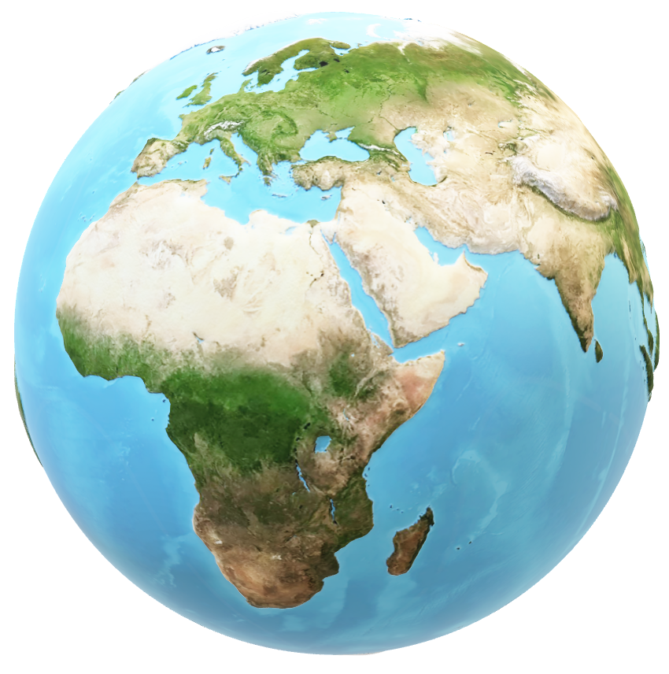
1
2
TOP 5 CITIES IN
THE WORLD
3
4
5

Slide 2
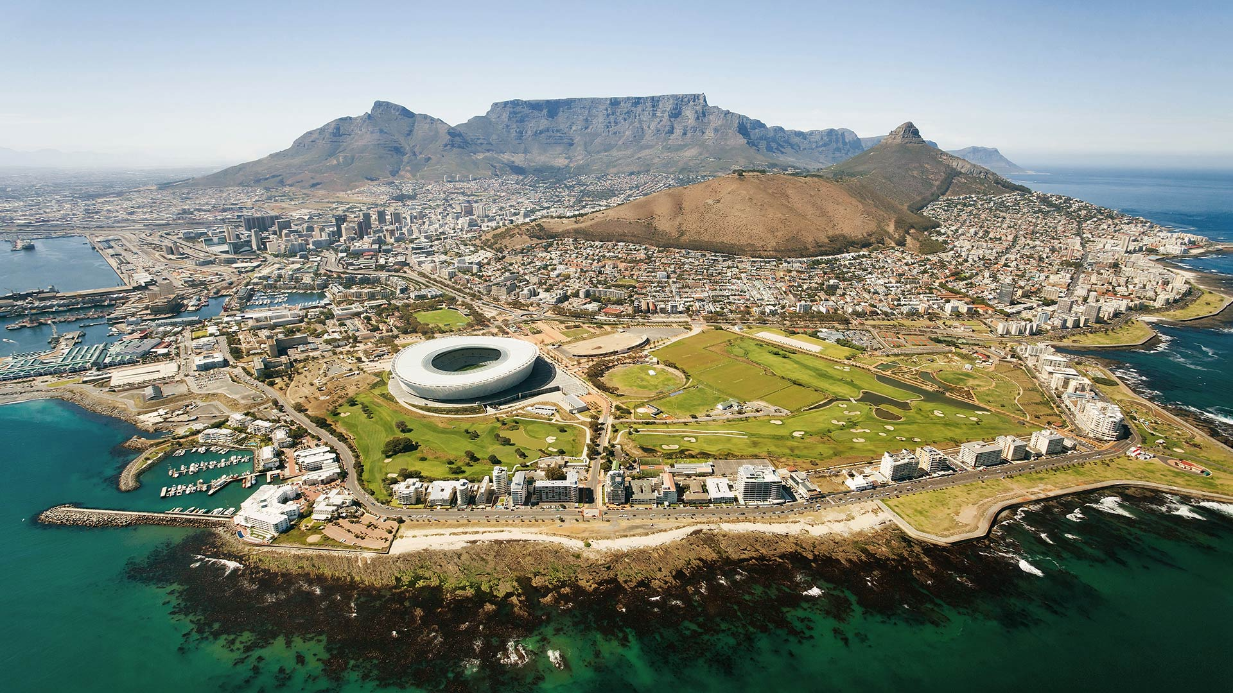
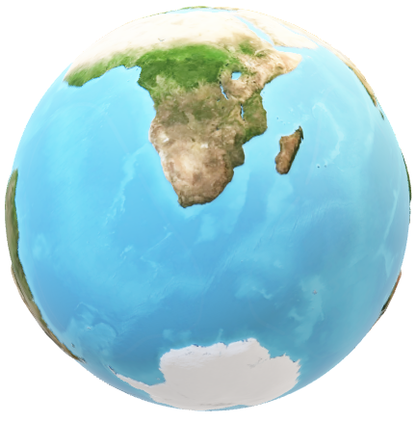
CAPE TOWN, S.A.
Description: Cape Town, nestled between the majestic Table Mountain and the glistening waters of the Atlantic Ocean, is a vibrant city with a rich cultural heritage and natural beauty. Visitors can ride the cable car to the summit of Table Mountain for panoramic views of the city, explore the historic Robben Island, or relax on the pristine beaches of Clifton and Camps Bay. With its eclectic mix of cuisines, thriving arts scene
1
2
TOP 5 CITIES IN
THE WORLD
3
4
5

Slide 3
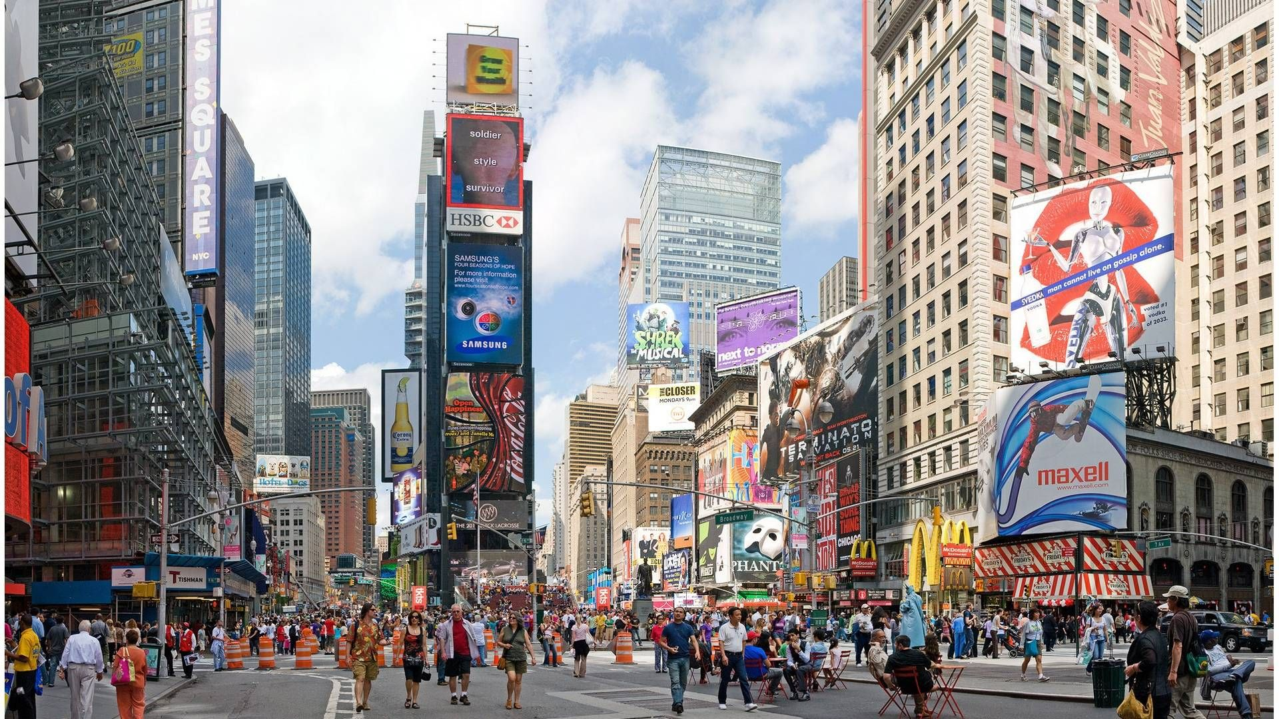

NEW YORK CITY,USA.
Description: New York City, often referred to as the "Big
Apple," is a melting pot of cultures, cuisines, and
attractions. From the bright lights of Times Square to the
tranquility of Central Park, the city offers a diverse range
of experiences for visitors. Explore world-class museums
like the Metropolitan Museum of Art, catch a Broadway
show in the Theatre District, or sample delicious street
food in multicultural neighborhoods like Chinatown.
1
2
TOP 5 CITIES IN
THE WORLD
3
4
5

Slide 4
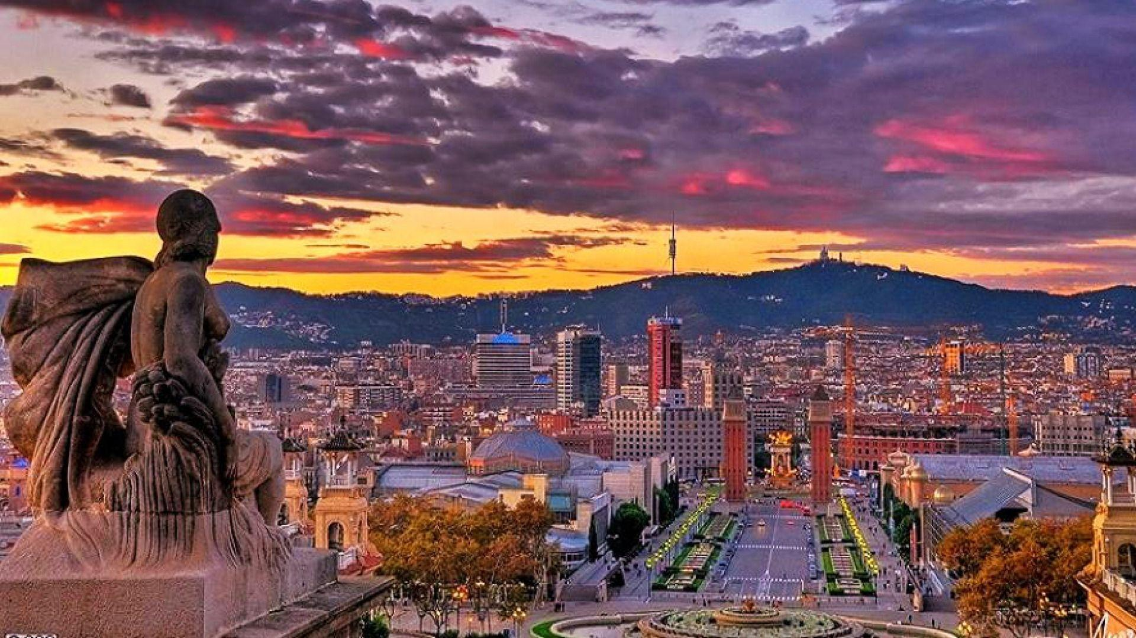
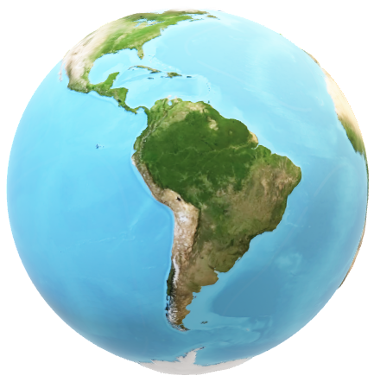
BARCELONA, SPAIN.
Description: Barcelona, the cosmopolitan capital of
Catalonia, is renowned for its stunning architecture,
vibrant culture, and lively atmosphere. At the heart of the
city lies the iconic Sagrada Familia, designed by
renowned architect Antoni Gaudi. Visitors can wander
through the narrow streets of the Gothic Quarter, marvel
at the colorful creations of Park Güell, and soak up the
sun on the beautiful beaches along the Mediterranean.
1
2
TOP 5 CITIES IN
THE WORLD
3
4
5

Slide 5
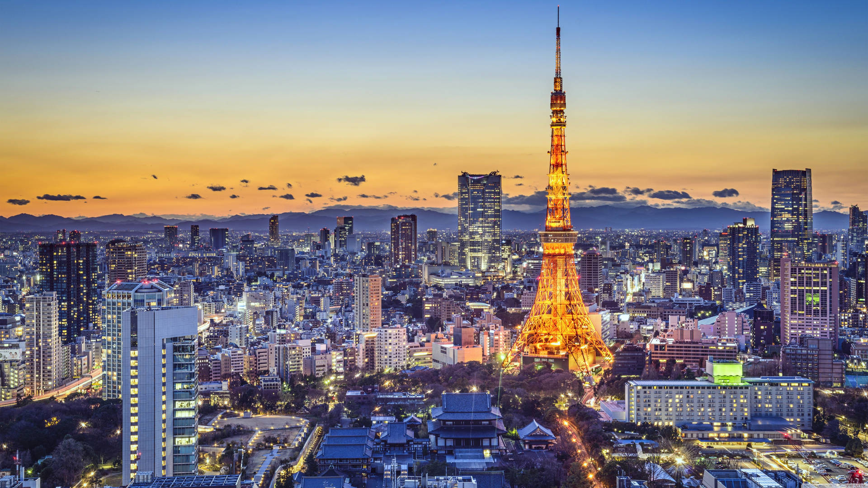
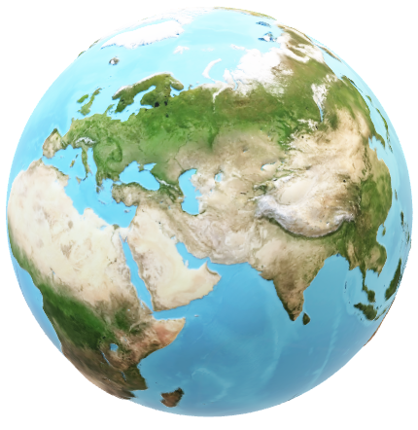
TOYKO, JAPAN.
Description: Tokyo, the bustling capital of Japan, is a
dynamic metropolis blending modernity with tradition. Skyscrapers stand tall alongside historic temples, creating a unique juxtaposition of old and new. From the bustling streets of Shibuya to the serene gardens of the Imperial Palace, Tokyo offers something for every traveler.
1
2
TOP 5 CITIES IN
THE WORLD
3
4
5

Slide 6
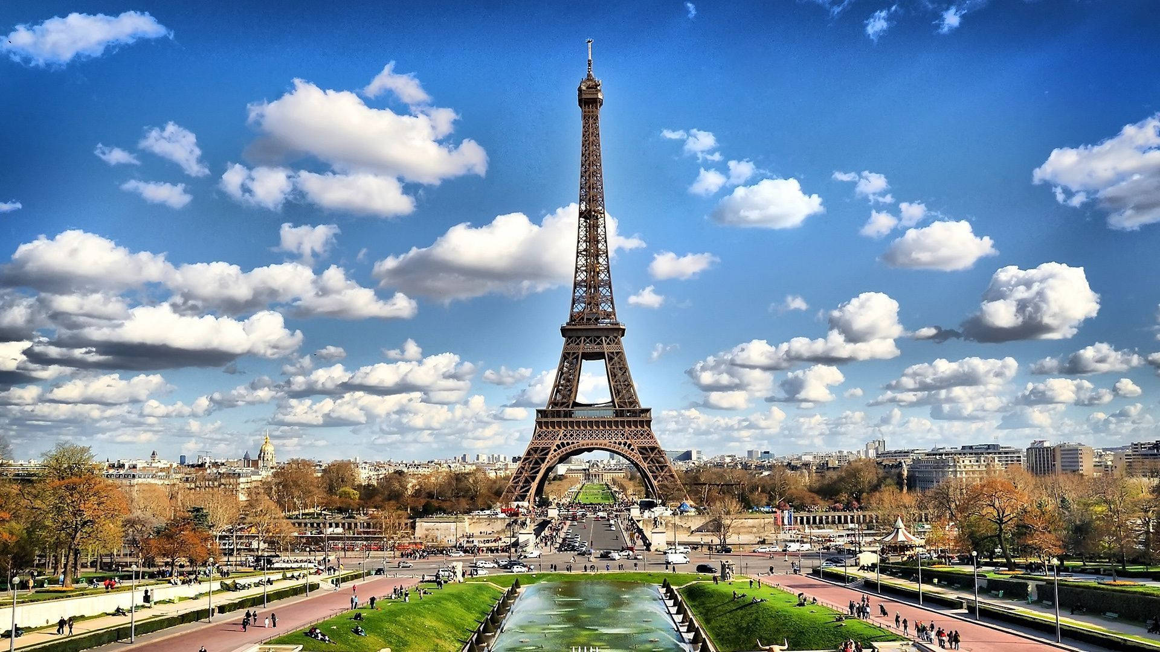

PARIS, FRANCE.
Paris, often called the "City of Love," is renowned for its romantic ambiance, iconic landmarks, and rich history. From the stunning Eiffel Tower to the magnificent Notre Dame Cathedral, Paris boasts an array of architectural marvels. Visitors can stroll along the Seine River, explore world-class museums like the Louvre, and indulge in delectable French cuisine.
1
2
TOP 5 CITIES IN
THE WORLD
3
4
5

Slide 7
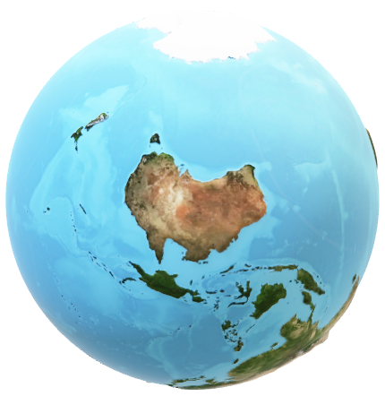
PARIS, FRANCE.
Paris, often called the "City of Love," is renowned for its romantic ambiance, iconic landmarks, and rich history. From the stunning Eiffel Tower to the magnificent Notre Dame Cathedral, Paris boasts an array of architectural marvels. Visitors can stroll along the Seine River, explore world-class museums like the Louvre, and indulge in delectable French cuisine.
1
TOP 5 CITIES IN
THE WORLD
2
3
4
5

